Slide 1





( April 2024 )

Slide 2


Technical Lead - MS Dynamics 365 CRM
am@techlabs.london
https://www.linkedin.com/in/aya-metwally
The Team behind http://iProperty.Cloud
Business Confidential – Do Not circulate

Slide 3
What is Power Platform
How Power Platform components interacts with Power Automate
Power Automate components:
Service Connectors
Built-in connectors
Connection
Connection reference
Triggers
Actions
Business Confidential – Do Not circulate

Slide 4
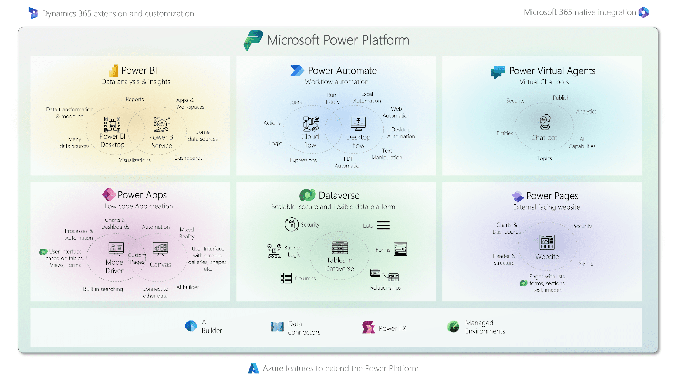
Business Confidential – Do Not circulate
Notes:
set of tools that allow you to build business applications
Power platform are Business tools not productivity tools like office
apps that businesses use things that are like databases that store their customer information or workflows that automate approvals or send notification
Power Platform has four different components

Slide 5
Business Confidential – Do Not circulate
Notes:
Power Apps allows you to build custom business applications this might be a mobile application
three different types of things that you can do with Power Apps: canvas apps, model driven app,
Blank canvas total design ability
on the screen and you can design right down to the last pixel exactly how you want that
Internal use for service worker for example

Slide 6
Business Confidential – Do Not circulate
Notes:
set of tools that allow you to build business applications
Power platform are Business tools not productivity tools like office
apps that businesses use things that are like databases that store their customer information or workflows that automate approvals or send notification
Power Platform has four different components

Slide 7
Business Confidential – Do Not circulate
Notes:
cloud flows this is a trigger and action type automation when
something happens do something else and this can include conditional branching so
great for automations of all kinds
robotic process automation this is also called in the platform desktop
automation so what this is about is where we want to automate across systems where we can't connect
to them programmatically it's using something called an API so this might be old web-based
systems or legacy green screen applications things where you can't do that connection where you're
actually recording your mouse clicks and your keyboard strokes and so on and then replicating
them so if you've got like an old system

Slide 8
Business Confidential – Do Not circulate
Notes:
Power Virtual Agents that allows you to create chat bots with no code
you don't have to be an expert in all of that stuff with natural language processing
you can authenticate users in by logging them in
it knows who they are or even an anonymous way you can have them be able to put in a receipt
number or an order number and retrieve their order information and then authorize a return within
rules so lots of things there where your chat bot can actually help with questions and answers but
also take advantage of being able to take action on behalf of the user

Slide 9
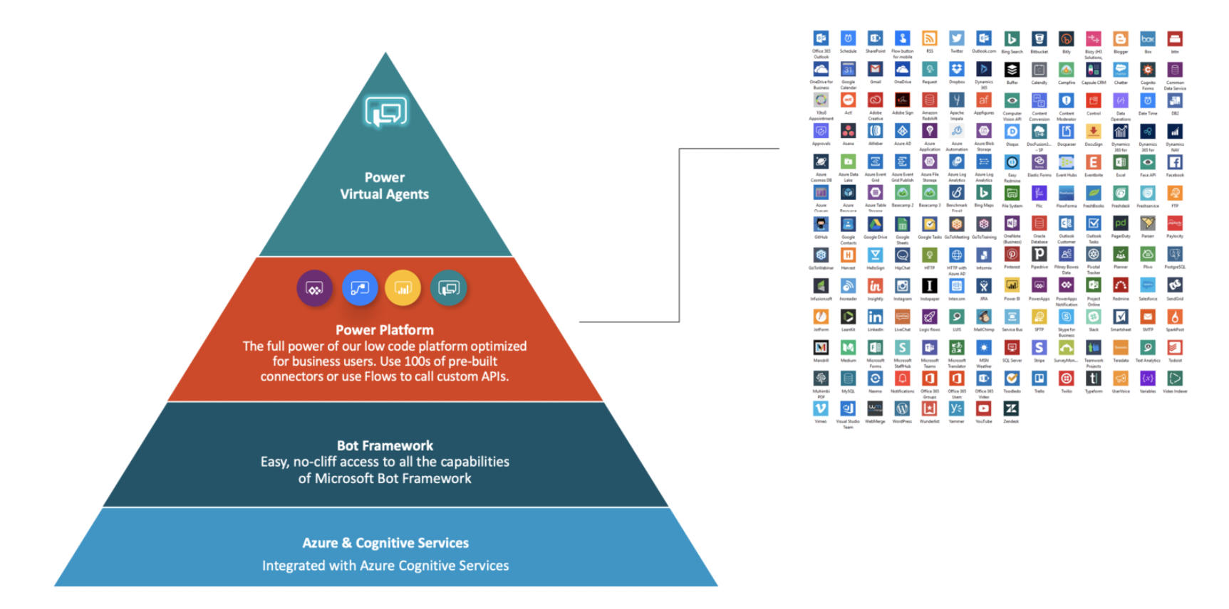
Notes:
How power automate serves PVA

Slide 10








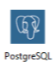












Slide 11
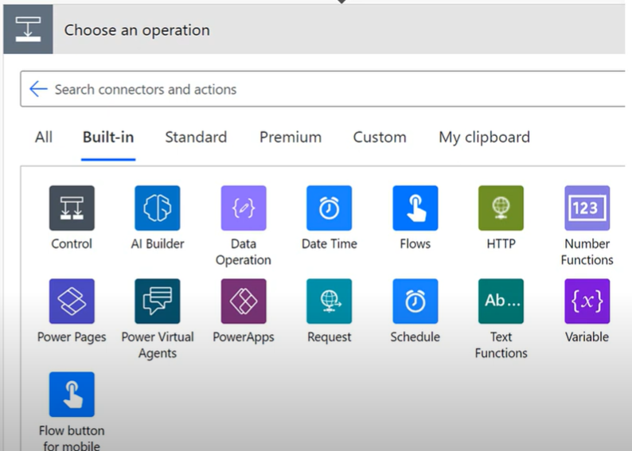
Built-in Connectors
Business Confidential – Do Not circulate

Slide 12
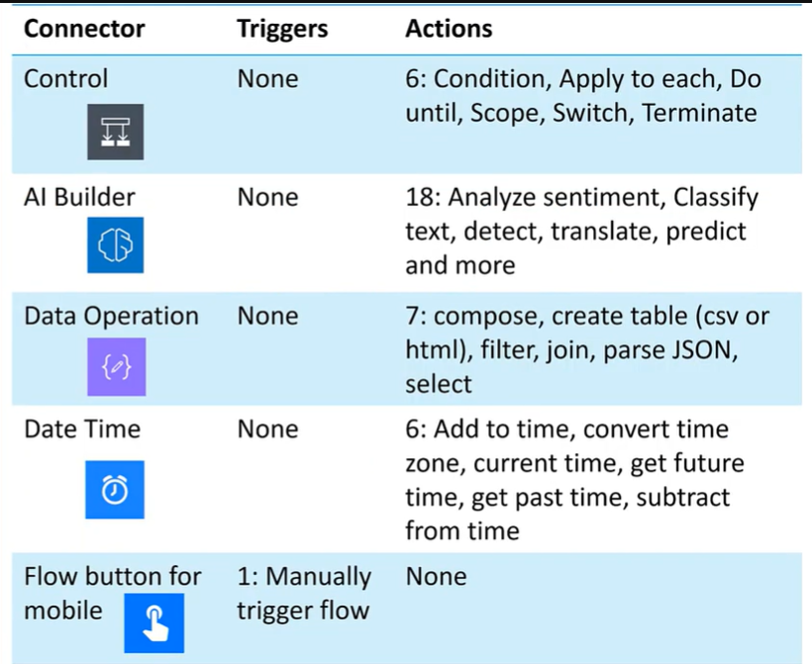
Built-in Connectors
Business Confidential – Do Not circulate

Slide 13
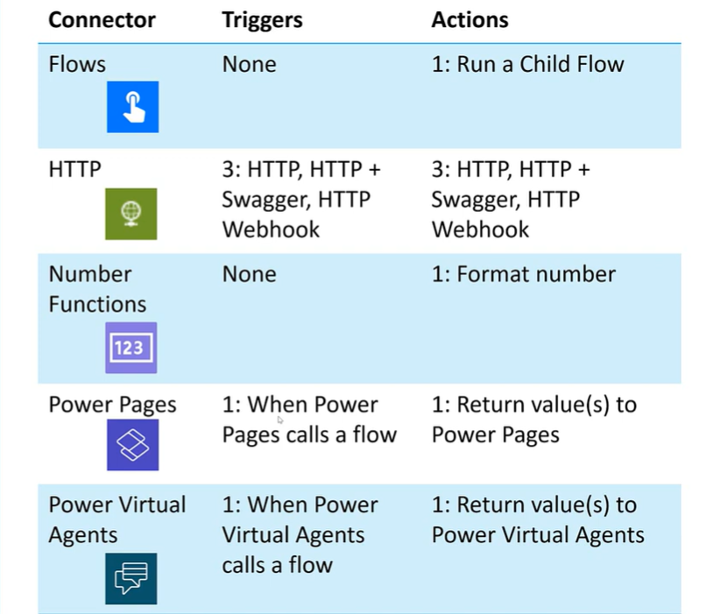
Business Confidential – Do Not circulate

Slide 14
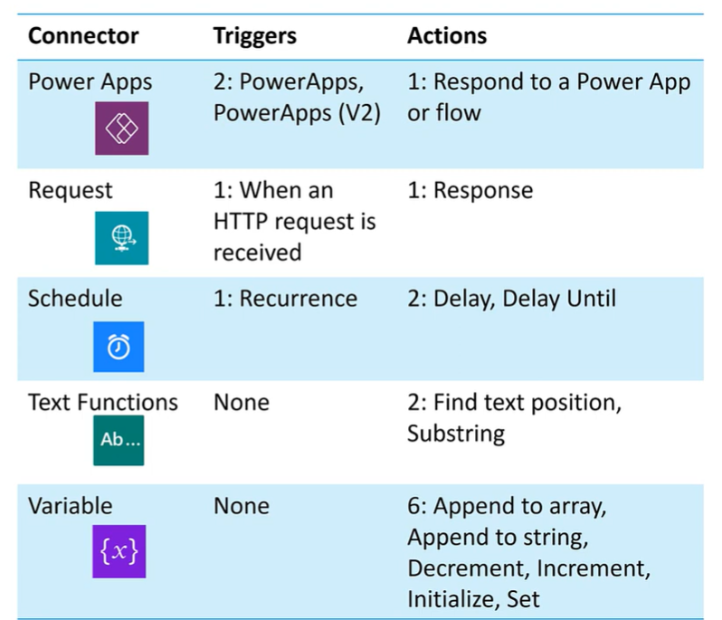
Business Confidential – Do Not circulate

Slide 15
Create Power Automate and WF to send email on field change Send Resolution email = yes (Ticket table) send to contact email and set resolution date.
If the account record has been deactivated, deactivate all tickets. Power Automate

